Slide 1
Transactions in DBMS
The transaction is a set of logically related operation. It contains a group of tasks.
A transaction is an action or series of actions. It is performed by a single user to perform operations for accessing the contents of the database.
Suppose an employee of bank transfers Rs 800 from X's account to Y's account.
X's Account
Open_Account(X)
Old_Balance = X.balance
New_Balance = Old_Balance - 800
X.balance = New_Balance
Close_Account(X)
Y's Account
Open_Account(Y)
Old_Balance = Y.balance
New_Balance = Old_Balance + 800
Y.balance = New_Balance
Close_Account(Y)

Slide 2
Operations
Read(X): Read operation is used to read the value of X from the database and stores it in a buffer in main memory.
Write(X): Write operation is used to write the value back to the database from the buffer.
Let's take an example to debit transaction from an account which consists of following operations:
R(X);
X = X - 500;
W(X);

Slide 3
Let's assume the value of X before starting of the transaction is 4000.
The first operation reads X's value from database and stores it in a buffer.
The second operation will decrease the value of X by 500. So buffer will contain 3500.
The third operation will write the buffer's value to the database. So X's final value will be 3500.

Slide 4
For example: If in the above transaction, the debit transaction fails after executing operation 2 then X's value will remain 4000 in the database which is not acceptable by the bank.
To solve this problem, we have two important operations:
Commit: It is used to save the work done permanently.
Rollback: It is used to undo the work done.

Slide 5
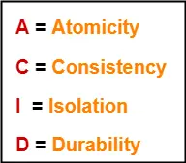
Properties of Transactions
ACID Properties-
It is important to ensure that the database remains consistent before and after the transaction.
To ensure the consistency of database, certain properties are followed by all the transactions occurring in the system.
These properties are called as ACID Properties of a transaction.

Slide 6
1. Atomicity-
This property ensures that either the transaction occurs completely or it does not occur at all.
In other words, it ensures that no transaction occurs partially.
That is why, it is also referred to as “All or nothing rule“.
It is the responsibility of Transaction Control Manager to ensure atomicity of the transactions.

Slide 7
2. Consistency-
In other words, it ensures that the database remains consistent before and after the transaction.
It is the responsibility of DBMS and application programmer to ensure consistency of the database.
3. Isolation-
This property ensures that multiple transactions can occur simultaneously without causing any inconsistency.
During execution, each transaction feels as if it is getting executed alone in the system.
A transaction does not realize that there are other transactions as well getting executed parallely.

Slide 8
Changes made by a transaction becomes visible to other transactions only after they are written in the memory.
The resultant state of the system after executing all the transactions is same as the state that would be achieved if the transactions were executed serially one after the other.
It is the responsibility of concurrency control manager to ensure isolation for all the transactions.

Slide 9
4. Durability-
This property ensures that all the changes made by a transaction after its successful execution are written successfully to the disk.
It also ensures that these changes exist permanently and are never lost even if there occurs a failure of any kind.
It is the responsibility of recovery manager to ensure durability in the database.

Slide 10
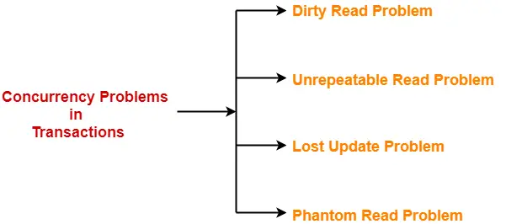
Concurrency Problems in DBMS-
When multiple transactions execute concurrently in an uncontrolled or unrestricted manner, then it might lead to several problems.
Such problems are called as concurrency problems.
The concurrency problems are-
re-

Slide 11
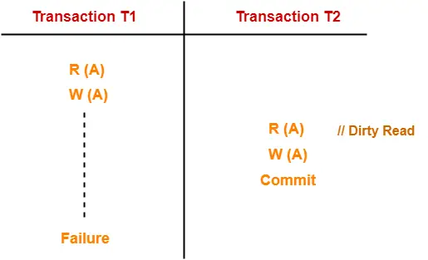
This read is called as dirty read because-
There is always a chance that the uncommitted transaction might roll back later.
Thus, uncommitted transaction might make other transactions read a value that does not even exist.
This leads to inconsistency of the database.

Slide 12
Here,
T1 reads the value of A.
T1 updates the value of A in the buffer.
T2 reads the value of A from the buffer.
T2 writes the updated the value of A.
T2 commits.
T1 fails in later stages and rolls back.
In the above example,
T2 reads the dirty value of A written by the uncommitted transaction T1.
T1 fails in later stages and roll backs.
Thus, the value that T2 read now stands to be incorrect.
Therefore, database becomes inconsistent.

Slide 13
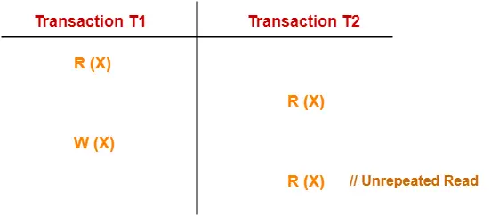
2. Unrepeatable Read Problem-
This problem occurs when a transaction gets to read unrepeated i.e. different values of the same variable in its different read operations even when it has not updated its value.

Slide 14
T1 reads the value of X (= 10 say).
T2 reads the value of X (= 10).
T1 updates the value of X (from 10 to 15 say) in the buffer.
T2 again reads the value of X (but = 15).
In this example,
T2 gets to read a different value of X in its second reading.
T2 wonders how the value of X got changed because according to it, it is running in isolation.

Slide 15
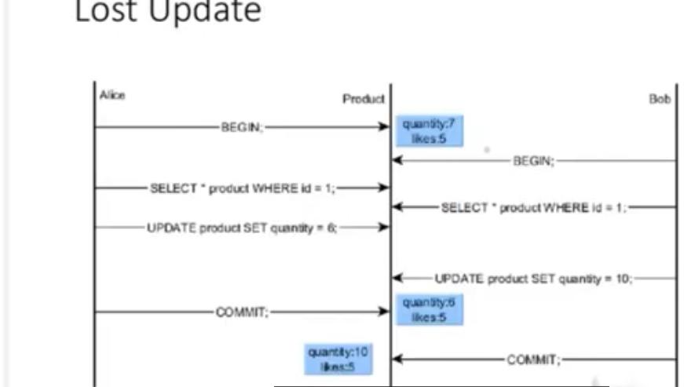
3. Lost Update Problem-
This problem occurs when multiple transactions execute concurrently and updates from one or more transactions get lost.

Slide 16
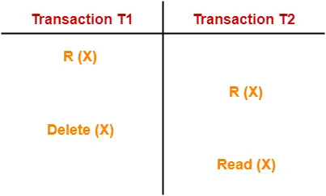
4. Phantom Read Problem-
This problem occurs when a transaction reads some variable from the buffer and when it reads the same variable later, it finds that the variable does not exist.

Slide 17
Here,
T1 reads X.
T2 reads X.
T1 deletes X.
T2 tries reading X but does not find it.
In this example,
T2 finds that there does not exist any variable X when it tries reading X again.
T2 wonders who deleted the variable X because according to it, it is running in isolation.

Slide 18
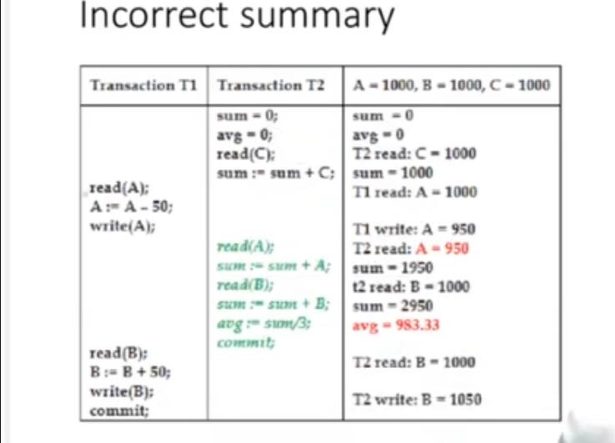
5. Incorrect Summary

Slide 19
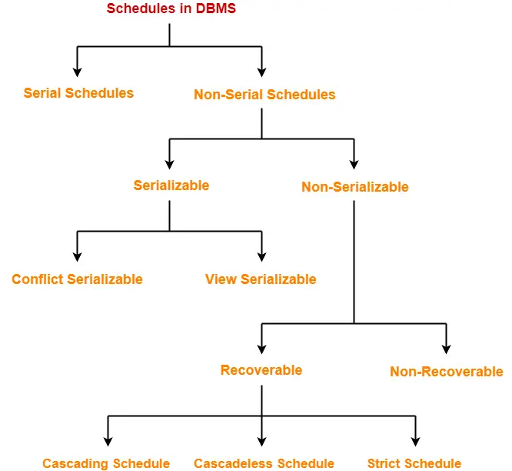
Schedules in DBMS-
The order in which the operations of multiple transactions appear for execution is called as a schedule.
Types of Schedules-
In DBMS, schedules may be classified as-

Slide 20
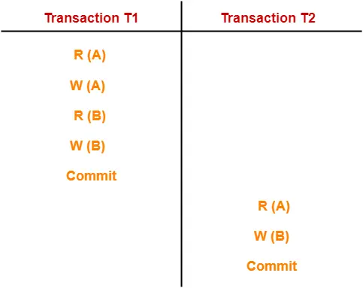
Serial Schedules-
In serial schedules,
All the transactions execute serially one after the other.
When one transaction executes, no other transaction is allowed to execute.
In this schedule,
There are two transactions T1 and T2 executing serially one after the other.
Transaction T1 executes first.
After T1 completes its execution, transaction T2 executes.
So, this schedule is an example of a Serial Schedule.

Slide 21
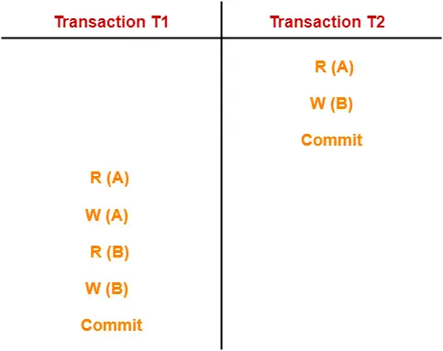
There are two transactions T1 and T2 executing serially one after the other.
Transaction T2 executes first.
After T2 completes its execution, transaction T1 executes.
So, this schedule is an example of a Serial Schedule.

Slide 22
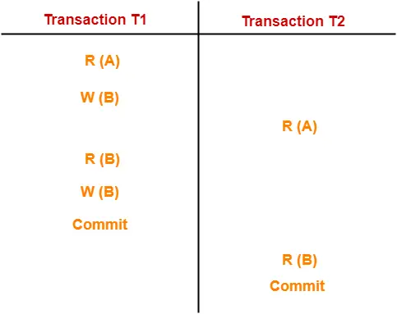
Non-Serial Schedules-
In non-serial schedules,
Multiple transactions execute concurrently.
Operations of all the transactions are inter leaved or mixed with each other.
In this schedule,
There are two transactions T1 and T2 executing concurrently.
The operations of T1 and T2 are interleaved.
So, this schedule is an example of a Non-Serial Schedule.

Slide 23
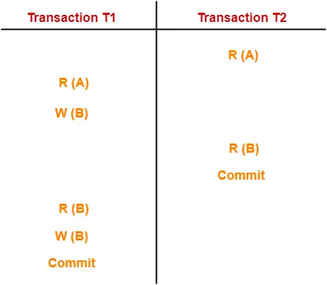
In this schedule,
There are two transactions T1 and T2 executing concurrently.
The operations of T1 and T2 are interleaved.
So, this schedule is an example of a Non-Serial Schedule.

Slide 24

Finding Number Of Schedules-
Consider there are n number of transactions T1, T2, T3 …. , Tn with N1, N2, N3 …. , Nn number of operations respectively.
Total Number of Schedules-
Total number of possible schedules (serial + non-serial) is given by-

Slide 25
Total Number of Serial Schedules-
Total number of serial schedules
= Number of different ways of arranging n transactions
= n!
Total Number of Non-Serial Schedules-
Total number of non-serial schedules
= Total number of schedules – Total number of serial schedules

Slide 26
PRACTICE PROBLEM BASED ON FINDING NUMBER OF SCHEDULES-
Problem-
Consider there are three transactions with 2, 3, 4 operations respectively, find-
How many total number of schedules are possible?
How many total number of serial schedules are possible?
How many total number of non-serial schedules are possible?

Slide 27
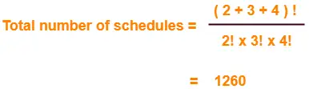
Total Number of Serial Schedules-
Total number of serial schedules
= Number of different ways of arranging 3 transactions
= 3!
= 6
Total Number of Non-Serial Schedules-
Total number of non-serial schedules
= Total number of schedules – Total number of serial schedules
= 1260 – 6
= 1254

Slide 28
Read-Write Problem
T1 | T2
R(A)
R(A)
A=A-2
W(A)
Commit
R(A)
W(A)
Commit

Slide 29
Write-Read Problem / Irrecoverable
T1 | T2
R(A)
W(A)
R(A)
A=A*2
W(A)
Commit
*
R(B)
R(C)

Slide 30
Write-Write Problem
T1 | T2
R(A)
W(A)
W(A)
Commit
Commit

Slide 31
Cascading Schedule
Multiple events occur automatically due to occurrence of single event.
T1 T2 T3 T4
R(A)
W(A)
R(A)
R(A)
R(A)
*

Slide 32
Cascadeless Schedule
Read operation is not allowed by other transactions until commit by T1.
T1 T2 T3
R(A)
W(A)
Commit
R(A)
R(A)

Slide 33
Strict Recoverable Schedule
Write-Write Operation- not allowed
T1 T2
R(A)
R(A)
W(A)
W(A)

Slide 34
Serializability
Serializability is a term that is a property of the system that describes how the different process operates the shared data.
T1 | T2
R(A)
W(A)
R(A)
W(A)
T1 | T2
R(A)
W(A)
R(A)
W(A)

Slide 35
T1 | T2
R(A)
R(A)
W(A)
W(A)
Parallel Schedule
Check whether any serial schedule equivalent to the above schedule exists or not.
Types of Serializability:
Conflict Serializability
2. View Serializability

Slide 36
Possibilities
T1->T2->T3
T1->T3->T2
T2->T3->T1
T2->T1->T3
T3->T1->T2
T3->T2->T1
S
T1 | T2 | T3
R(A)
R(A)
W(A)
W(A)
R(B)
W(B)
W(B)

Slide 37
Conflict Equivalent Schedule
Find the Conflict equivalent schedule for the given schedule.
or
Check whether two schedules are conflict equivalent with each other or not.
S
T1 T2
R(A)
W(A)
R(A)
W(A)
R(B)
S1
T1 T2
R(A)
W(A)
R(B)
R(A)
W(A)

Slide 38
R(A) R(A)
R(A) W(A)
W(A) R(A)
W(A) W(A)
R(B) R(A)
W(B) R(A)
R(B) W(A)
W(B) W(A)
Conflict Pairs
Non Conflict Pairs

Slide 39
S
T1 T2
R(A)
W(A)
R(A)
R(B)
W(A)
S
T1 T2
R(A)
W(A)
R(B)
R(A)
W(A)
Final S
Now S and S1 are Conflict Equivalent Schedules

Slide 40
Example 2:
S
T1 T2
R(A)
W(A)
R(A)
W(A)
R(B)
S1
T1 T2
R(A)
W(A)
R(B)
R(A)
W(A)
Conflict Pairs - no change in positions
S and S1 are not Conflict Serializable.

Slide 41
Conflict Serializability using precedence graph
Check conflict pairs in other transactions and draw edge.
T1 T2 T3
R(X)
R(Y)
R(X)
R(Y)
R(Z)
W(Y)
W(Z)
R(Z)
W(X)
W(Z)

Slide 42
Check Conflict pair for R(X) in T1 --- W(X)
It is not existing in either T2 or T3.Hence Discard.
Check Conflict pair for R(Y) in T3 --- W(Y)
It is not existing in either T2 or T1.Hence Discard.
Check Conflict pair for R(X) in T3 --- W(X)
It is not existing in T2 but exists in T1. Draw an edge from T3 to T1 and discard R(X) in T3.
Check Conflict pair for R(Y) in T2 --- W(Y)
It exists in T3. Draw an edge from T2 to T3 and discard R(Y) in T2.
Check Conflict pair for R(Z) in T2 --- W(Z)
It (W(Z)) exists in T1. Draw an edge from T2 to T1 and discard R(Z) in T2.
No Conflict pairs for W(Y) in T3 with other transactions.

Slide 43
It (W(Z)) exists in T1. Draw an edge from T2 to T1 and discard R(Z) in T2.
No Conflict pairs for W(Y) in T3 with other transactions.
Check Conflict pair for W(Z) in T2 --- W(Z) in T1 and R(Z) in T1.
Edge already existed from T2 to T1 so no need to draw an edge again.
As remaining operations are only in T1 we cannot compare them with other transactions. So discard all the three.
Check if loop exists in this graph.
T1
T2
Note: If a Schedule is conflict serializable it is serial and consistent.
T3

Slide 44
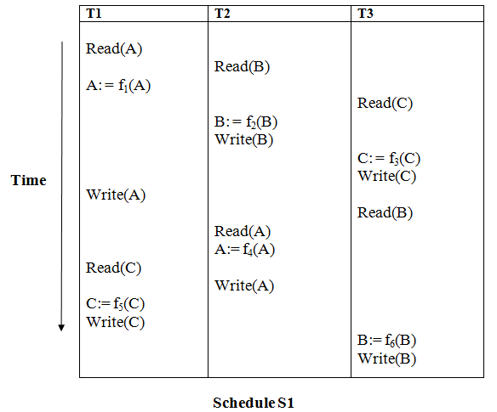

Slide 45
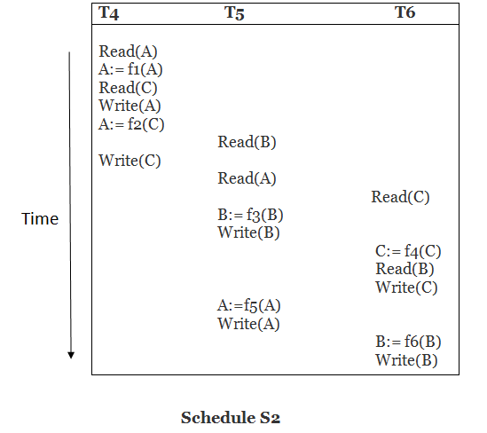

Slide 46
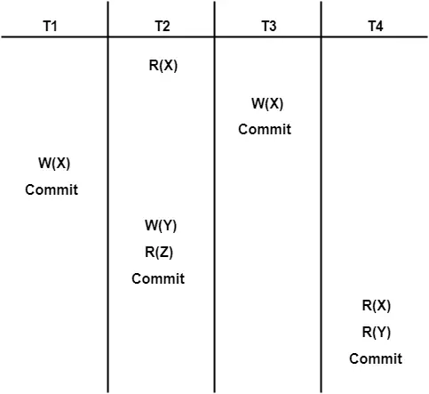
Check whether the given schedule S is conflict serializable and recoverable or not-

Slide 47
Checking Whether S is Conflict Serializable Or Not-
Step-01:
List all the conflicting operations and determine the dependency between the transactions-
R₂(X) , W₃(X) (T₂ → T₃)
R₂(X) , W₁(X) (T₂ → T₁)
W₃(X) , W₁(X) (T₃ → T₁)
W₃(X) , R₄(X) (T₃ → T₄)
W₁(X) , R₄(X) (T₁ → T₄)
W₂(Y) , R₄(Y) (T₂ → T₄)
Step-02:
Draw the precedence graph-

Slide 48
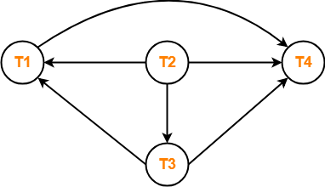
Clearly, there exists no cycle in the precedence graph.
Therefore, the given schedule S is conflict serializable.

Slide 49
Checking Whether S is Recoverable Or Not-
Conflict serializable schedules are always recoverable.
Therefore, the given schedule S is recoverable.

Slide 50
View Serializability
T₁ | T₂ | T₃
a=100 read(a)
 | a=a-40 write(a) //60
a=a-40 write(a) //20
 |  | a=a-20 write(a) //0

Slide 51
Checking Whether a Schedule is View Serializable Or Not-
Method-01:
Check whether the given schedule is conflict serializable or not.
If the given schedule is conflict serializable, then it is surely view serializable. Stop and report your answer.
If the given schedule is not conflict serializable, then it may or may not be view serializable. Go and check using other methods.
Method-02:
Check if there exists any blind write operation.
(Writing without reading is called as a blind write).
If there does not exist any blind write, then the schedule is surely not view serializable. Stop and report your answer.
If there exists any blind write, then the schedule may or may not be view serializable. Go and check using other methods.

Slide 52
Method-03:
In this method, try finding a view equivalent serial schedule.
By using the above three conditions, write all the dependencies.
Then, draw a graph using those dependencies.
If there exists no cycle in the graph, then the schedule is view serializable otherwise not.

Slide 53
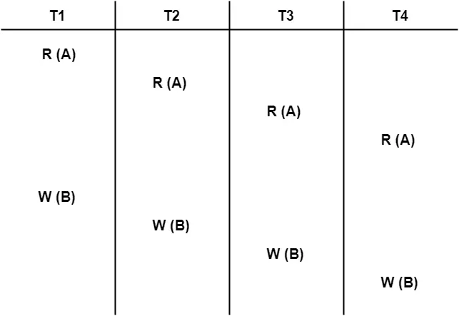
Check whether the given schedule S is view serializable or not-

Slide 54
Checking Whether S is Conflict Serializable Or Not-
Step-01:
List all the conflicting operations and determine the dependency between the transactions-
W₁(B) , W₂(B) (T₁ → T₂)
W₁(B) , W₃(B) (T₁ → T₃)
W₁(B) , W₄(B) (T₁ → T₄)
W₂(B) , W₃(B) (T₂ → T₃)
W₂(B) , W₄(B) (T₂ → T₄)
W₃(B) , W₄(B) (T₃ → T₄)
Step-02:
Draw the precedence graph-

Slide 55
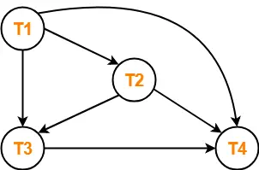
Clearly, there exists no cycle in the precedence graph.
Therefore, the given schedule S is conflict serializable.
Thus, we conclude that the given schedule is also view serializable.

Slide 56
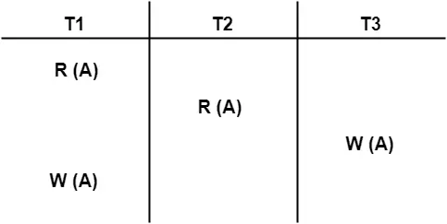
Check whether the given schedule S is view serializable or not-

Slide 57
Checking Whether S is Conflict Serializable Or Not-
Step-01:
List all the conflicting operations and determine the dependency between the transactions-
R₁(A) , W₃(A) (T₁ → T₃)
R₂(A) , W₃(A) (T₂ → T₃)
R₂(A) , W₁(A) (T₂ → T₁)
W₃(A) , W₁(A) (T₃ → T₁)
Step-02:
Draw the precedence graph-

Slide 58
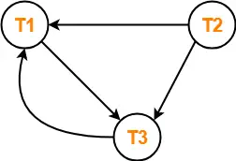
Clearly, there exists a cycle in the precedence graph.
Therefore, the given schedule S is not conflict serializable.
Now,
Since, the given schedule S is not conflict serializable, so, it may or may not be view serializable.
To check whether S is view serializable or not, let us use another method.
Let us check for blind writes.
Checking for Blind Writes-
There exists a blind write W₃ (A) in the given schedule S.
Therefore, the given schedule S may or may not be view serializable.

Slide 59
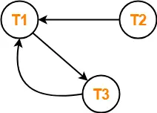
To check whether S is view serializable or not, let us use another method.
Let us derive the dependencies and then draw a dependency graph.
Drawing a Dependency Graph-
T1 firstly reads A and T3 firstly updates A.
So, T1 must execute before T3.
Thus, we get the dependency T1 → T3.
Final updation on A is made by the transaction T1.
So, T1 must execute after all other transactions.
Thus, we get the dependency (T2, T3) → T1.
There exists no write-read sequence.
Now, let us draw a dependency graph using these dependencies-
Clearly, there exists a cycle in the dependency graph.
Thus, we conclude that the given schedule S is not view serializable.

Slide 60
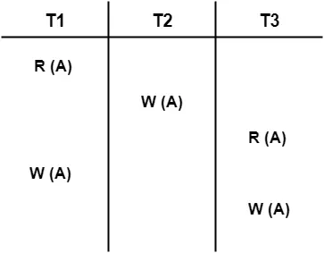
Problem-04:
Check whether the given schedule S is view serializable or not. If yes, then give the serial schedule.
S : R₁(A) , W₂(A) , R₃(A) , W₁(A) , W₃(A)

Slide 61
LookSchedule S’₁ :
In the above example if we do swapping among some transaction’s operation so our table will look like this –
T₁ | T₂ | T₃
a=100 read(a) //100
a=a-40 write(a) //60
 | a=a-40 write(a) //20
 |  | a=a-20 write(a) //0

Slide 62
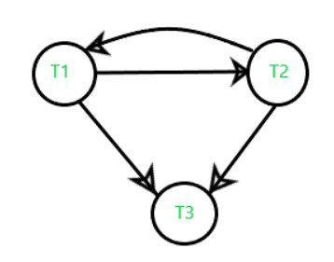

Slide 63
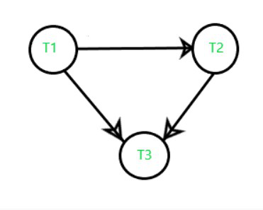

Slide 64
Irrecoverable Schedules-
If in a schedule,
A transaction performs a dirty read operation from an uncommitted transaction
And commits before the transaction from which it has read the value then such a schedule is known as an Irrecoverable Schedule.
Example-
Consider the following schedule-

Slide 65
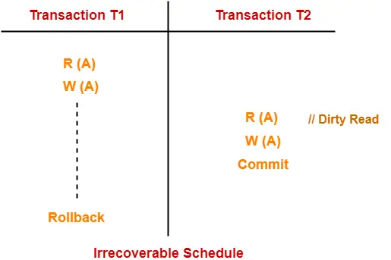

Slide 66
T2 performs a dirty read operation.
T2 commits before T1.
T1 fails later and roll backs.
The value that T2 read now stands to be incorrect.
T2 can not recover since it has already committed.

Slide 67
Recoverable Schedules-
If in a schedule,
A transaction performs a dirty read operation from an uncommitted transaction
And its commit operation is delayed till the uncommitted transaction either commits or roll backs then such a schedule is known as a Recoverable Schedule.
Here,
The commit operation of the transaction that performs the dirty read is delayed.
This ensures that it still has a chance to recover if the uncommitted transaction fails later.

Slide 68
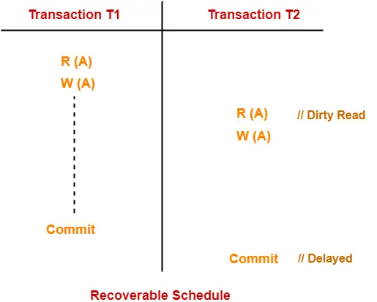

Slide 69
Here,
T2 performs a dirty read operation.
The commit operation of T2 is delayed till T1 commits or roll backs.
T1 commits later.
T2 is now allowed to commit.
In case, T1 would have failed, T2 has a chance to recover by rolling back.

Slide 70
Checking Whether a Schedule is Recoverable or Irrecoverable-
Method-01:
Check whether the given schedule is conflict serializable or not.
If the given schedule is conflict serializable, then it is surely recoverable. Stop and report your answer.
If the given schedule is not conflict serializable, then it may or may not be recoverable. Go and check using other methods.
Method-02:
Check if there exists any dirty read operation.(Reading from an uncommitted transaction is called as a dirty read)
If there does not exist any dirty read operation, then the schedule is surely recoverable. Stop and report your answer.
If there exists any dirty read operation, then the schedule may or may not be recoverable.
If there exists a dirty read operation, then follow the following cases-

Slide 71
Case-01:
If the commit operation of the transaction performing the dirty read occurs before the commit or abort operation of the transaction which updated the value, then the schedule is irrecoverable.
Case-02:
If the commit operation of the transaction performing the dirty read is delayed till the commit or abort operation of the transaction which updated the value, then the schedule is recoverable.

Slide 72
Lock-Based Protocol
In this type of protocol, any transaction cannot read or write data until it acquires an appropriate lock on it. There are two types of lock:
Shared Lock – Also known as a Read-only lock.If transaction locked data item in shared mode, then only read operation
is allowed.
It can be shared between the transactions because when the transaction holds a lock, then it can't update the data on
the data item.
Exclusive Lock - If transaction locked data item in exclusive mode then both read and write are allowed.
This lock is exclusive, and in this lock, multiple transactions do not modify the same data simultaneously.
T1
S(A)- shared lock on A
R(A)
U(A) - unlock
T2
X(A)- Exclusive Lock on A
R(A)
W(A)
U(A)

Slide 73
Compatibility Table
Request
S
X
(A)
Yes | No
No | No
Grant
Problems in Shared Exclusive Locking
Not sufficient to produce only serializable schedule
Not free from Irrecoverability
Not free from deadlock
Not free from Starvation

Slide 74
1.
T1 | T2
X(A)
R(A)
W(A)
U(A)
S(A)
R(A)
U(A)
X(B)
R(B)
W(B)
U(A)
Non Serializable Schedule

Slide 75
2.
T1 | T2
X(A)
R(A)
W(A)
U(A)
. S(A)
R(A)
.
.
Commit
.
.
.
*
Irrecoverability

Slide 76
3.
T1 | T2
X(A)
X(B)
X(B)
X(A)
Deadlock

Slide 77
4.
T1 T2 T3 T4
S(A)
X(A)
S(A)
U(A) S(A)
U(A)
U(A)
Starvation

Slide 78
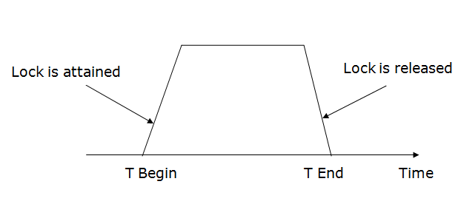
Two-phase locking (2PL)
The two-phase locking protocol divides the execution phase of the transaction into three parts.
In the first part, when the execution of the transaction starts, it seeks permission for the lock it requires.
In the second part, the transaction acquires all the locks. The third phase is started as soon as the transaction releases its first lock.
In the third phase, the transaction cannot demand any new locks. It only releases the acquired locks.

Slide 79
T1
X(A)
S(B)
R(A)
W(A)
R(B)
S(A)
R(C)
R(D)
U(A)
There are two phases of 2PL:
Growing phase: In the growing phase, a new lock on the data item may be acquired by the transaction, but none can be released.
Shrinking phase: In the shrinking phase, existing lock held by the transaction may be released, but no new locks can be acquired.
Growing Phase
Shrinking Phase

Slide 80
T1 | T2
X(A)
R(A)
W(A)
S(A)
R(A)
S(B)
R(B)
U(A)
Growing
Phase
Shrinking
Phase

Slide 81
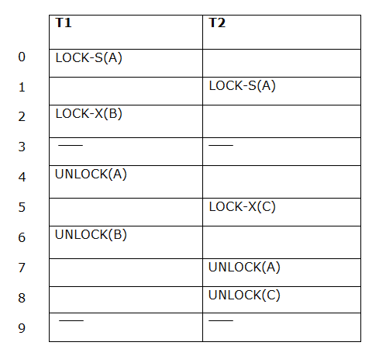
The following way shows how unlocking and locking work with 2-PL.
Transaction T1:
Growing phase: from step 1-3
Shrinking phase: from step 5-7
Lock point: at 3
Transaction T2:
Growing phase: from step 2-6
Shrinking phase: from step 8-9
Lock point: at 6

Slide 82
Time Stamp Ordering Protocol
Rules:
Transaction T_{i} issues Read(A) Operation
a) if WTS(A)> TS(T_{i}), Rollback T_{i}
b) Otherwise execute R(A) Operation
Set RTS(A)=Max{RTS(A),TS(T_{i})}
Transaction Tissues Write(A) Operation
a) if RTS(A)> TS(T_{i}), Rollback T_{i}
b) if WTS(A)> TS(T_{i}), Rollback T_{i}
c) Otherwise execute W(A) Operation
Set WTS(A)=TS(T_{i})

Slide 83
Database Recovery
Database recovery techniques are used in database management systems (DBMS) to restore a database to a consistent state after a failure or error has occurred.
The main goal of recovery techniques is to ensure data integrity and consistency and prevent data loss.

Slide 84
Log-Based Recovery
The log is a sequence of records. Log of each transaction is maintained in some stable storage so that if any failure occurs, then it can be recovered from there.
If any operation is performed on the database, then it will be recorded in the log.
But the process of storing the logs should be done before the actual transaction is applied in the database.

Slide 85
Let's assume there is a transaction to modify the City of a student. The following logs are written for this transaction.
When the transaction is initiated, then it writes 'start' log.
<Tn, Start>
When the transaction modifies the City from 'Noida' to 'Bangalore', then another log is written to the file.
<Tn, City, 'Noida', 'Bangalore' >
When the transaction is finished, then it writes another log to indicate the end of the transaction.
<Tn, Commit>

Slide 86
There are two approaches to modify the database:
Deferred database modification:
The deferred modification technique occurs if the transaction does not modify the database until it has committed.
In this method, all the logs are created and stored in the stable storage, and the database is updated when a transaction commits.

Slide 87
T1
R(A)
A= A+100
W(A)
R(B)
B= B+200
W(B)
Commit
Log for T1
<T1, Start>
<T1,A,200>
<T1,B,400>
<T1,Commit>

Slide 88
How to perform Deferred database modification?
If System fails before commit, Recovery manager will open transaction log and check whether T1 executed
start and commit statements.
If yes, it performs Redo Operation where new values will be stored in the database.
Recovery Manager takes decision based on log file.
If Recovery Manager finds only Start but not Commit then it’ll perform Rollback operation.
Database now contains only old values.

Slide 89
Example:
<T1,Start>
<T1,A,200>
<T1,B,400>
<T1,Commit>
<T2,Start>
<t2,C,500>
Redo
Roll back

Slide 90
Immediate Database Modification
The Immediate modification technique occurs if database modification occurs while the transaction is still active.
In this technique, the database is modified immediately after every operation. It follows an actual database modification.

Slide 91
T1
R(A)
A= A+100
W(A)
R(B)
B= B+200
W(B)
Commit
Log for T1
<T1, Start>
<T1,A,100,200>
<T1,B,200,400>
<T1,Commit>

Slide 92
Recovery Manager will check whether T1 executed Start and Commit Stataments. If Yes, perform Redo Operation.
Save new values in the database.
Values stored in the database will be overwritten with new values.
If transaction has only Start without Commit then Recovery Manager perform Undo Operation and save old values
In the database.

Slide 93
Example:
<T1,Start>
<T1,A,100,200>
<T1,B,500,600>
<T1,Commit>
<T2,Start>
<t2,C,700,800>
Redo
Undo

Slide 94
Checkpoint
The checkpoint is a type of mechanism where all the previous logs are removed from the system and permanently stored in the storage disk.
The checkpoint is like a bookmark. While the execution of the transaction, such checkpoints are marked, and the transaction is executed then using the steps of the transaction, the log files will be created.
When it reaches to the checkpoint, then the transaction will be updated into the database, and till that point, the entire log file will be removed from the file. Then the log file is updated with the new step of transaction till next checkpoint and so on.
The checkpoint is used to declare a point before which the DBMS was in the consistent state, and all transactions were committed.

Slide 95
Why do We Need Checkpoints?
Whenever transaction logs are created in a real-time environment, it eats up lots of storage space.
Also keeping track of every update and its maintenance may increase the physical space of the system.
Eventually, the transaction log file may not be handled as the size keeps growing.
This can be addressed with checkpoints.
The methodology utilized for removing all previous transaction logs and storing them in permanent storage is called a Checkpoint.

Slide 96
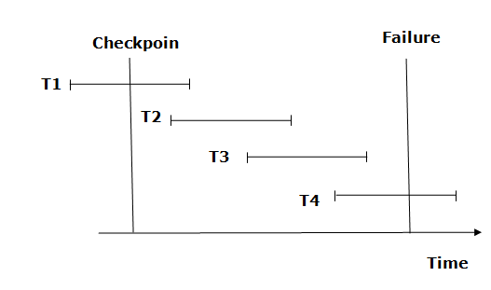
Recovery using Checkpoint

Slide 97
The transaction is put into undo state if the recovery system sees a log with <Tn, Start> but no commit or abort log found. In the undo-list, all the transactions are undone, and their logs are removed.
For example: Transaction T4 will have <Tn, Start>. So T4 will be put into undo list since this transaction is not yet complete and failed amid.

Slide 98
The recovery system reads log files from the end to start. It reads log files from T4 to T1.
Recovery system maintains two lists, a redo-list, and an undo-list.
The transaction is put into redo state if the recovery system sees a log with <Tn, Start> and <Tn, Commit> or just <Tn, Commit>. In the redo-list and their previous list, all the transactions are removed and then redone before saving their logs.
For example: In the log file, transaction T2 and T3 will have <Tn, Start> and <Tn, Commit>. The T1 transaction will have only <Tn, commit> in the log file. That's why the transaction is committed after the checkpoint is crossed. Hence it puts T1, T2 and T3 transaction into redo list.

Slide 99
Shadow Paging
Alternative method to log based recovery
Require fewer disk accesses then log based method.
Database is partitioned into number of fixed length blocks which are referred to as pages.
Assume that there are ‘n’ pages numbered from 1 to n. These pages are not stored in any particular order
on the disk.
Each entry contains pointer to page on disk.

Slide 100
Key Idea:
Maintain 2 page tables during transaction i.e current page table and shadow page table.
When transaction starts, both tables are identical.
Shadow page table remains constant while changes are made in current page table.
Directory contains 2 page tables. When we execute any transactions, updations will be done in current page table.
After commit, operations performed till commit will be copied to shadow page table.
All I/O Operations use current page table to locate database pages on disk.

Slide 101
Directory
Current Page Table
Shadow Page Table
After Commit
identical
Transaction starts

